Slide 1
pSMILE Laboratory Instructions for the Web-Based Investigation Form
By Heidi Hanes
Senior pSMILE Coordinator

Slide 2
Objectives
By the end of this presentation, the audience will be able to:
Navigate to Web-based Investigation link.
Complete all required fields of the investigation.
Upload any supporting documentation for the investigation.
Submit the finalized investigation for review by pSMILE and PNL.

Slide 3
Notes:
SMILE will be moving the following investigations forms to the web- Quantitative, Qualitative and Microbiology. SmartSpot investigation will continue to be sent to SmartSpot. The other investigation not changing to the web is the MTS Vaginal Wet Prep. This will continue on the paper form.

Slide 4
Harmonized ID: HID0403 SMILE Mnemonic: TestLAB Laboratory Name: Test Laboratory City, Country: Baltimore, United States
Dear TestLAB Laboratory Team,
EQA Updates
I have reviewed the following EQA surveys and the results are summarized below:
CAP VM (Viral Markers) 2020/B Investigation Required for Anti-HBc (IgM)
Pending Investigation: CAP FH9 (Hematology) 2020/2 - Blood Cell ID: Current event CAP VPBS (Virtual Peripheral Blood Smear) 2020/1 - WBC Differential: Current event CAP D (Bacteriology) 2020/1 - Bacteria ID: Current event CAP CGL (Coagulation) 2020/1 - Activated PTT, quant: Current event CAP GH5I (HgbA1C International) 2020/1 - HBA1c %: Current event CAP C (Chemistry ) 2020/2 - Calcium, Cholesterol - LDL, measured, Cholesterol - Total: Current event CAP GH5I (HgbA1C International) 2020/2 - HBA1c %: Current event CAP VM (Viral Markers) 2020/2 - Anti-HBc (IgM): Current event
Please log in to psmile.org to view your current pending investigations. Please contact me with any questions regarding EQA status or if you need assistance with investigation steps. Congratulations on your successful performance on this survey event.
Notes:
When a new investigation is required will show on your regular monthly email for EQA/Action plan Follow your own SOP for completing EQA Investigations The slide shows an example of the email that is sent. A comment has been added seen here is red to direct you to the website for the investigations.

Slide 5
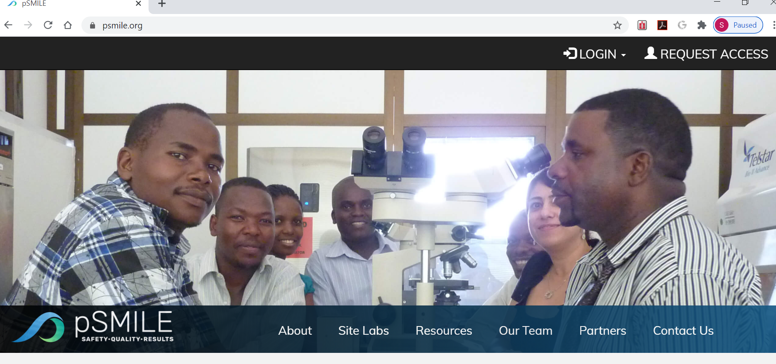
Notes:
Anybody filling out investigations online will need to access to our psmile.org site. They should click on “Request Access”

Slide 6
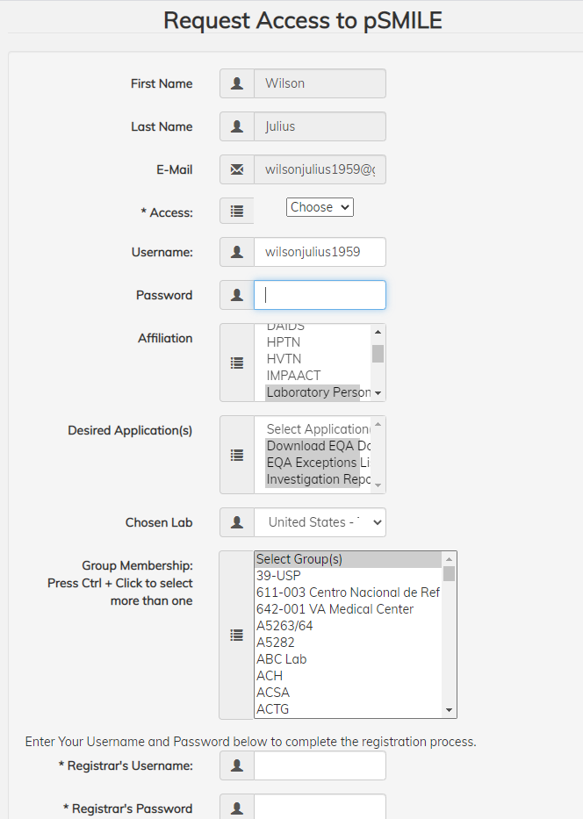
Notes:
Make sure in the request you specify which site you are requesting and so you can access the new IR website

Slide 7
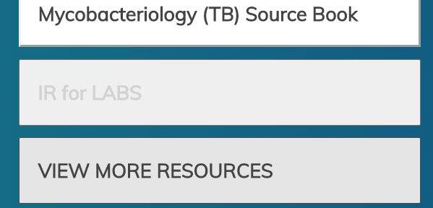
Notes:
Under the Quick Links click on IR for LABS. This will take you to the IR list

Slide 8
Notes:
Your list will contain all of your site’s pending investigations. You will be able to tell which ones need to be processed by the lab because under the “Who has it? Column Will say LAB . Click on View IR

Slide 9
Notes:
To work on it off line use the print button in the upper right corner to save a copy or print it. Also at the upper right can access the SMILE guideline for this IR to help you fill out the form.

Slide 10
Notes:
The correct type of investigation form will be populated. The Analyzer Name/Model should be confirmed and the rest need to be filled in

Slide 11
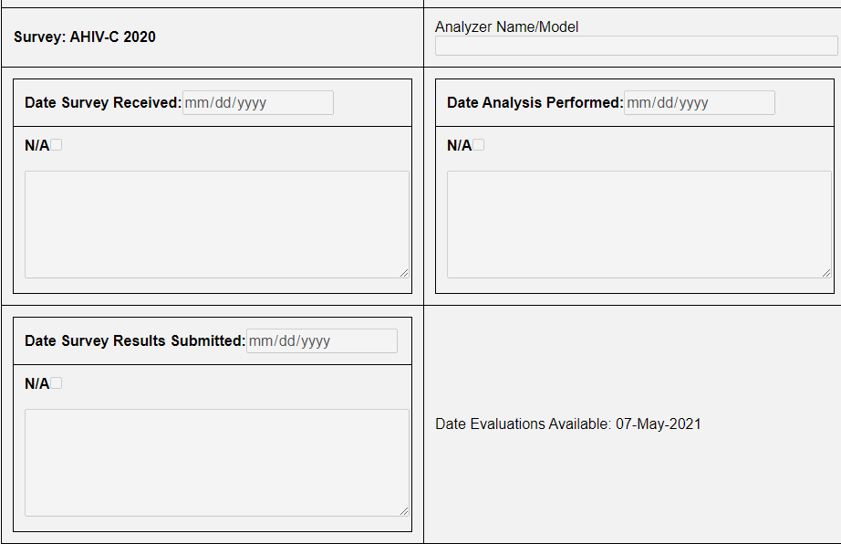
Notes:
If the laboratory never received the survey instead of entering dates for the received, performed and submitted dates can click on N/A and enter comment why did not perform the testing. Either dates or comments must be entered in this section.

Slide 12
Notes:
Under the unacceptable EQA Panel the following will be filled out

Slide 13
For surveys that have not been resulted and are graded as 0%. In the Unacceptable EQA Panel section only one line per analytes will appear.
If results can be run then they should be attached as a document and enter in Repeated Result box “See Attachment” .
If results cannot be run then fill out the Explanation section.
Notes:
If for whatever reason the site does not enter results for a survey and does not contact pSMILE a score of 0% will be given. For these analytes only one line will appear for all results. If the survey can be run the site should attach the results to the investigation which will be explain in this training. In the Repeated Result Box enter “See Attachments” If the results cannot be run then in the Explanation box enter the reason why they were not.

Slide 14
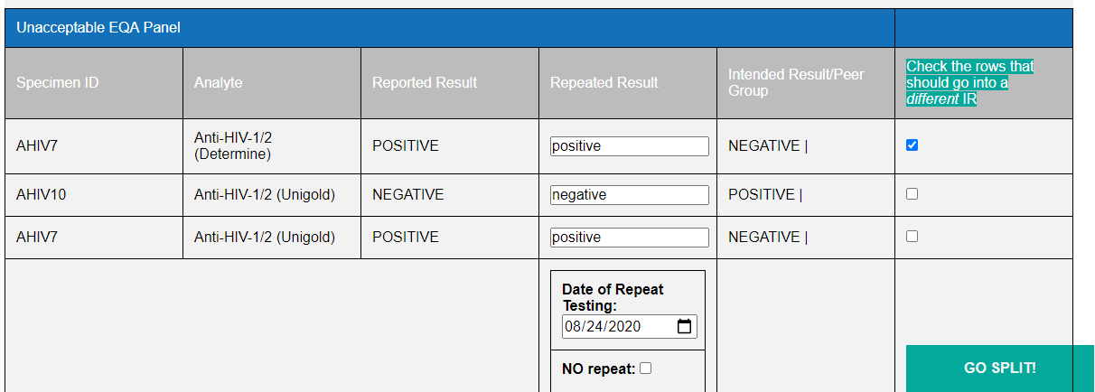
Notes:
If the survey has several analytes that require an investigation the laboratory needs to decide if need only one investigation or multiple. If investigation shows same cause can use one but if different causes then they should be split. If you need to split click on the Enable Split IR, Then click in box of analyte to split , then click on “go split”

Slide 15
Notes:
. This will create two separate ones in this case. Just make sure you want them separate. Can’t put back together

Slide 16
Notes:
Under the three section – Pre-Analytical, Analytical and Post Analytical need to check the appropriate box and add any comments to help explain choice such as Survey arrived warm temperature was 37 C upon receipt.

Slide 17
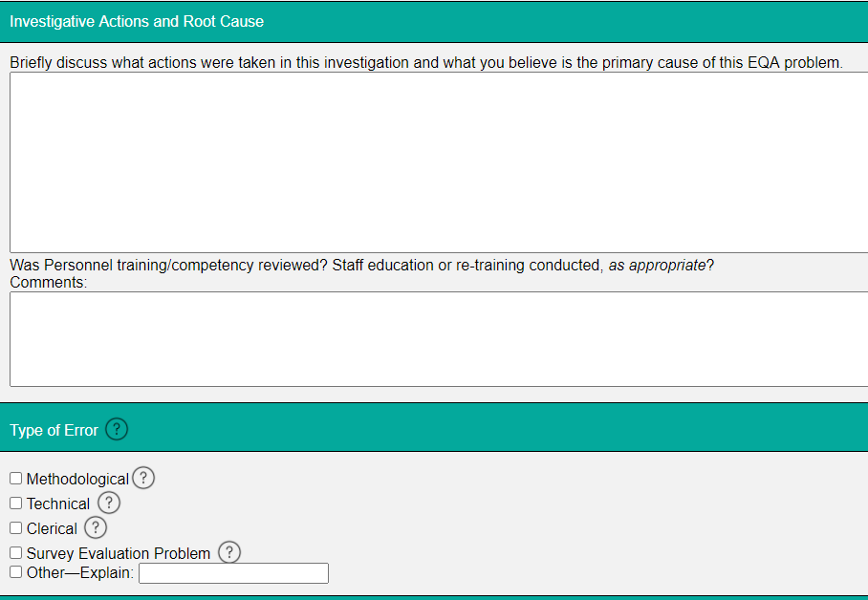
Notes:
Fill in the Investigative Actions and Root Cause, Personnel training/competency reviewed, and Type of error if check “Other” must explain what it was

Slide 18
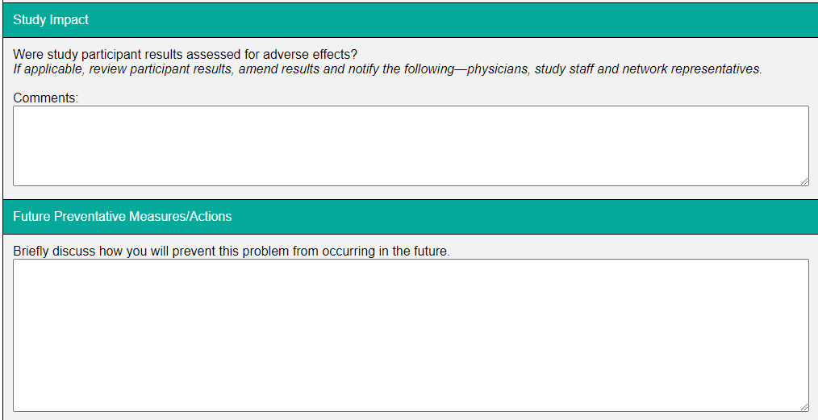
Notes:
Finally fill in the Study Impact and Future Preventative Measures/Action. . If the investigation is saved these comments can be edited but once the IR is submitted they become permanent. If the IR goes back to the lab additional comments can be added.

Slide 19
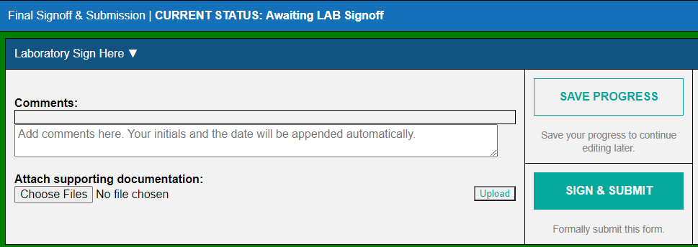
Notes:
The final section to fill in is the Final Signoff and Submission section. If you have any other comments to add put in the comment box. You don’t need to enter anything here if don’t want. At any point in completing the IR form you can save your work using the “Save Progress” button. Everything already filled out will be saved..

Slide 20
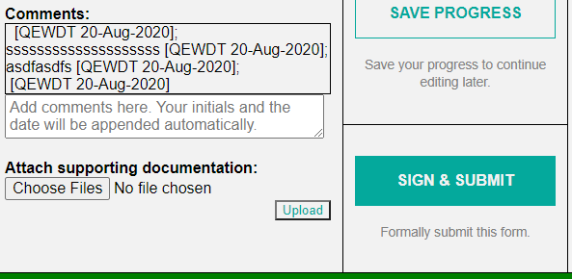
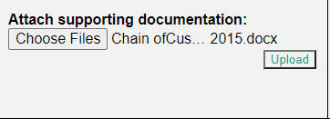
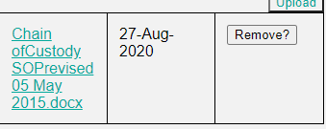
Notes:
If you have any documents for your investigations such as repeated results sheets, QC charts, service reports these can be submitted to be reviewed by SMILE and the Networks by using the ‘Choose Files’ button. This will open a tab to navigate to the documents. Once document is chosen click open and it will appear in this section. Click on “Upload” to attach. The document will appear and you can click on it to open to confirm correct document. If not can remove using the “Remove” button.

Slide 21
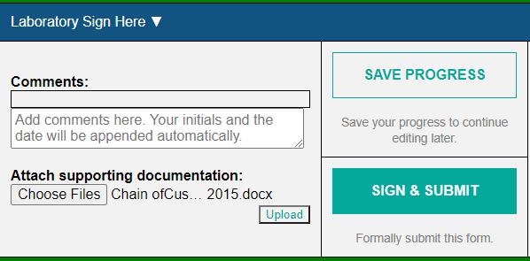
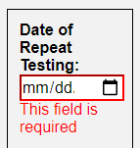
Notes:
. Once all fields have been completed the investigation can be submitted by using the Sign & Submit button. If there are any missing fields will get a pop-up telling you to complete required fields that will show up in red saying This Field is required.

Slide 22
An email is sent to the laboratory and pSMILE after the laboratory has submitted the investigation.
pSMILE will review the completed investigation.

Slide 23
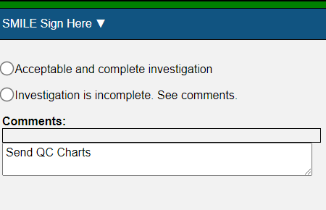
pSMILE will review the entire Investigation and either accept or reject the IR.
If rejected the primary contact and personnel who fill out the Investigation if different will receive an email to revise the IR.
The email will also be sent to pSMILE.
Notes:
Once laboratory updates the investigation and submits an email will be sent telling SMILE to review

Slide 24
After pSMILE accepts the Investigation the Laboratory, pSMILE and Networks will receive an email to review the Investigation.
The Network PNL will review the IR.

Slide 25
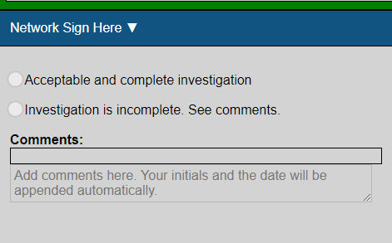
The PNL will have the choice of accepting or rejecting the Investigation. If rejected the IR will be returned to the laboratory to revise.
An email will be sent to the laboratory, pSMILE and Networks saying it is back with the laboratory.
Notes:
An email will be sent again to the main contact and person that completed IR. Once lab submitted will return to SMILE to review and eventually to the Network PNL

Slide 26
The investigation will be reviewed by pSMILE and then PNL Network
Once both pSMILE and the PNL accepts the Investigation an email is sent to DAIDS POC to acknowledge the investigation.
Notes:
Once accepted by both SMILE and PNL SMILE an email is sent to the DAIDS POC to acknowledge the investigation.

Slide 27
pSMILE will close the Investigation and combine all investigations with any supporting documents.
Notes:
Once DAIDS POC has acknowledged the investigation an email is sent to the lab and pSMILE coordinators will print out the completed IR, attach any documents that were submitted by the laboratory. If multiple IR for one survey all will be combined into one PDF. This will then be sent out to the mail group for that laboratory.

Slide 28
Questions

