Slide 1



pSMILE Network Instructions for the Web-Based Investigation Form
By Heidi Hanes
Senior pSMILE Coordinator

Slide 2
Objectives
By the end of this presentation, the audience will be able to:
  Navigate to Web-based Investigation link.
  Complete all required field of the investigation.
  Submit the investigation.

Slide 3
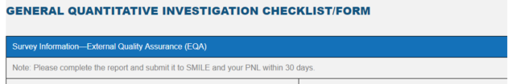
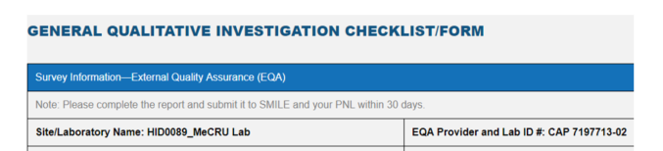
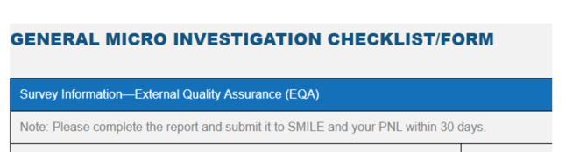
Notes:
SMILE will be moving the following investigations forms to the web-based version: Quantitative, Qualitative and Microbiology. The SmartSpot investigation will continue to be sent to SmartSpot. The MTS Vaginal Wet Prep investigation report will also not be moved to the web-based form. This will continue on the paper form.

Slide 4
Harmonized ID: HID0403
SMILE Mnemonic: TestLAB
Laboratory Name: Test Laboratory
City, Country: Baltimore, United States
Dear TestLAB Laboratory Team,
EQA Updates
I have reviewed the following EQA surveys and the results are summarized below:
CAP VM (Viral Markers) 2020/B
Investigation Required for Anti-HBc (IgM)
Pending Investigation:
CAP FH9 (Hematology) 2020/2 - Blood Cell ID: Current event
CAP VPBS (Virtual Peripheral Blood Smear) 2020/1 - WBC Differential: Current event
CAP D (Bacteriology) 2020/1 - Bacteria ID: Current event
CAP CGL (Coagulation) 2020/1 - Activated PTT, quant: Current event
CAP GH5I (HgbA1C International) 2020/1 - HBA1c %: Current event
CAP C (Chemistry ) 2020/2 - Calcium, Cholesterol - LDL, measured, Cholesterol - Total: Current event
CAP GH5I (HgbA1C International) 2020/2 - HBA1c %: Current event
CAP VM (Viral Markers) 2020/2 - Anti-HBc (IgM): Current event
Please log in to psmile.org to view your current pending investigations.
Please contact me with any questions regarding EQA status or if you need assistance with investigation steps. Congratulations on your successful performance on this survey event.
Notes:
When a new investigation is required it will show on regular monthly email for EQA/Action plan. A comment has been added, seen here is red, to direct you to the website for the investigations.

Slide 5
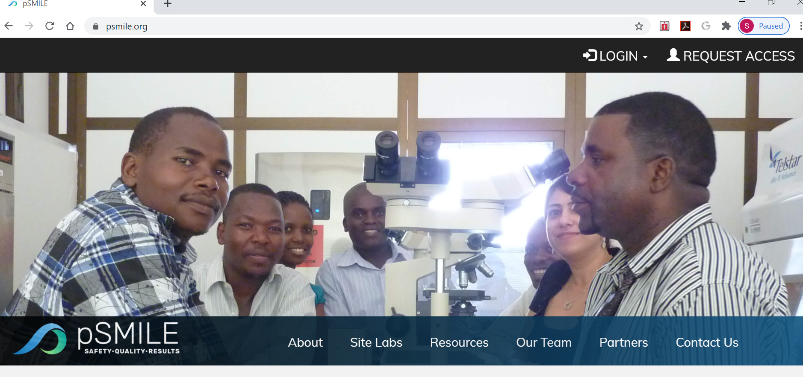
Notes:
Network representatives will need access to our psmile.org site. If you do not have access please click “Request Access”

Slide 6
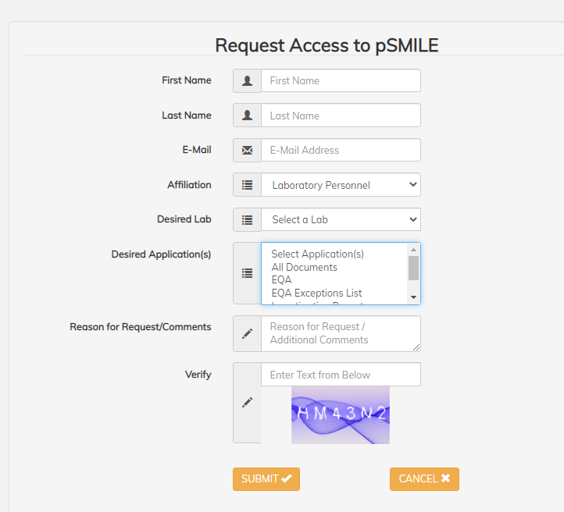
Notes:
Make sure you specify which affiliation you are requesting in the form, so you can access the new web-based IR for that laboratory

Slide 7

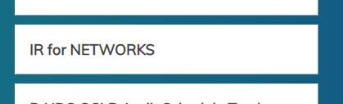
Notes:
Under the Quick Links click on IR for Networks. This will take you to the IR list

Slide 8
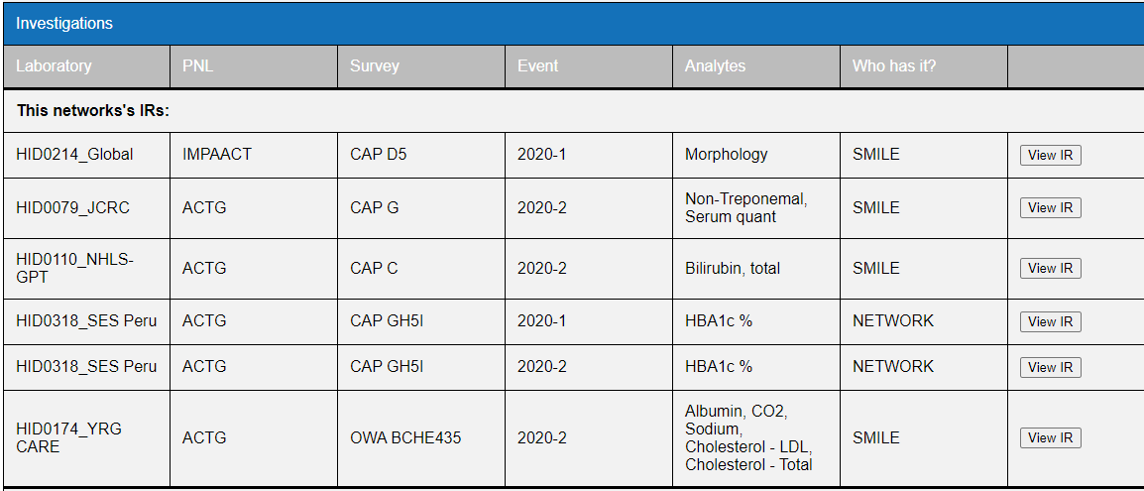
Notes:
The top section will list all of the pending investigation(s) for which you are the PNL. You will be able to tell which ones need to be processed by the your network because under the “Who has it? Column itwill say Network . The investigation can be viewed by clicking on “View IR”

Slide 9
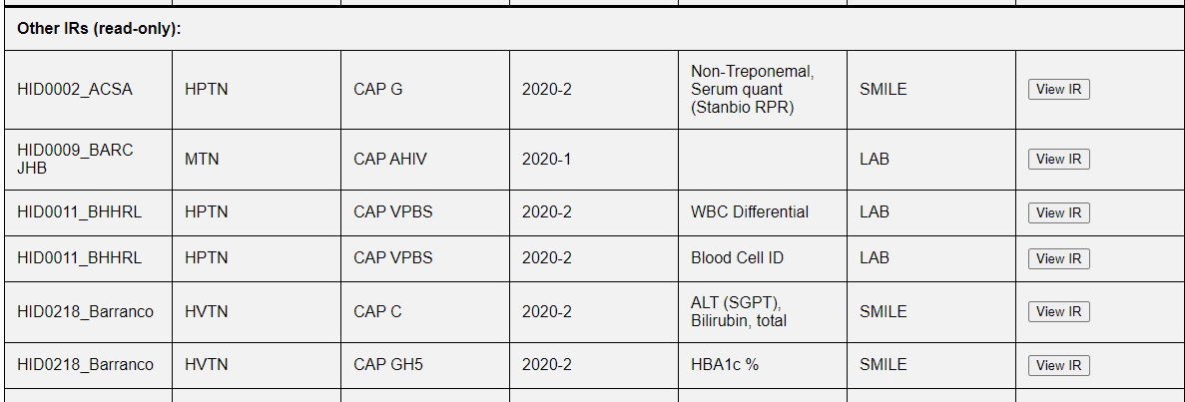
Notes:
Below the PNL list there is another list under the heading “Other IRS (read-only). All networks will be able to view the investigation in process but will not able to access any of the investigation sections

Slide 10
Notes:
At the bottom all closed investigations will be listed under “Closed IRs”

Slide 11
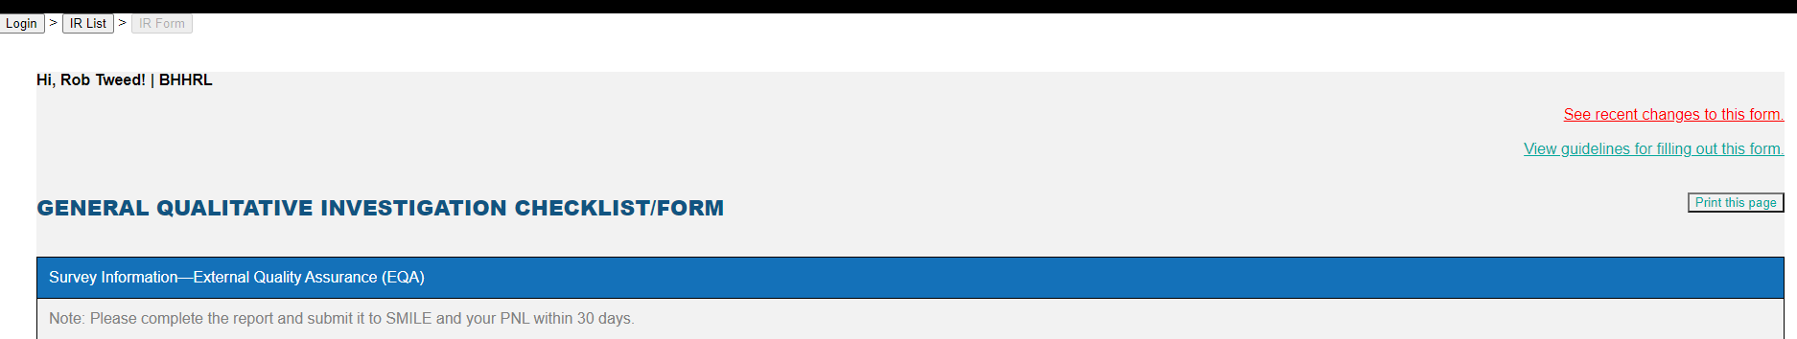
Notes:
If you click on the See recent changes to this form a document will come up with all of the changes and versions of the IR.

Slide 12
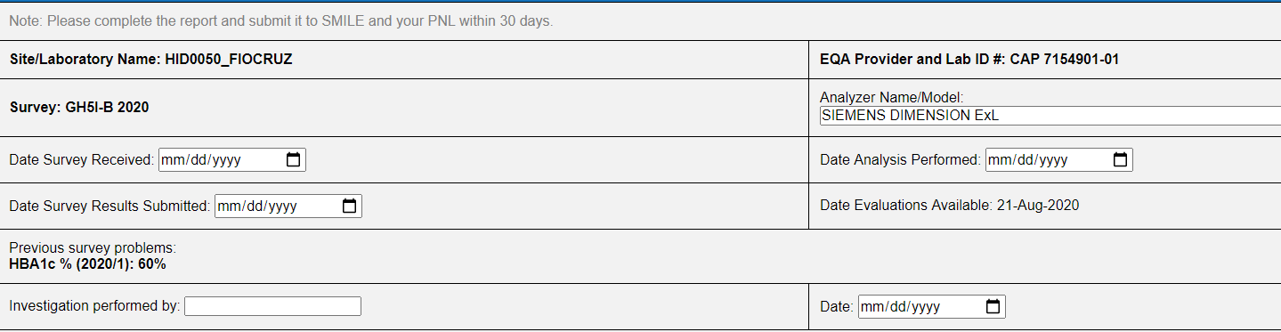
Notes:
The correct type of investigation form will be populated. The Analyzer Name/Model should be confirmed and the rest need to be filled in

Slide 13
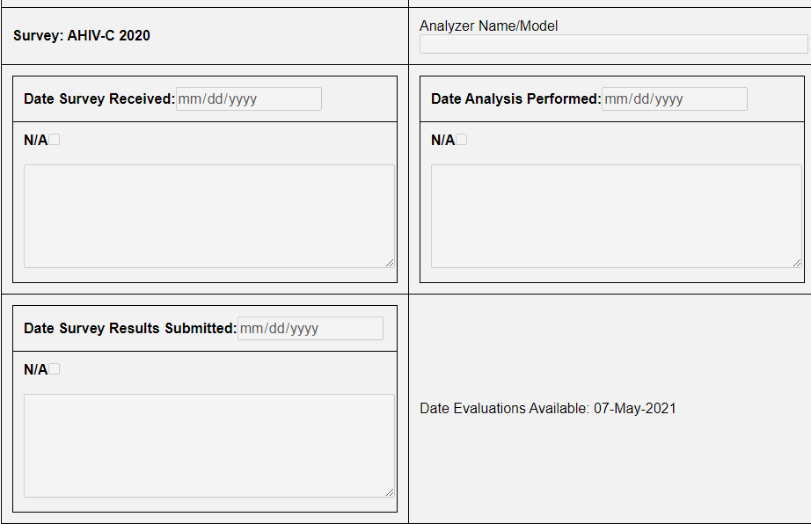
Notes:
If the laboratory never received the survey instead of entering dates for the received, performed and submitted dates can click on N/A and enter comment why did not perform the testing. Either dates or comments must be entered in this section.

Slide 14
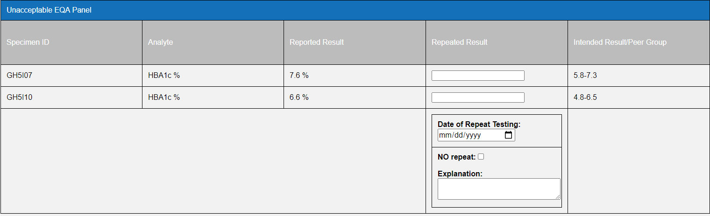
Notes:
Under the unacceptable EQA Panel the following will be filled out

Slide 15
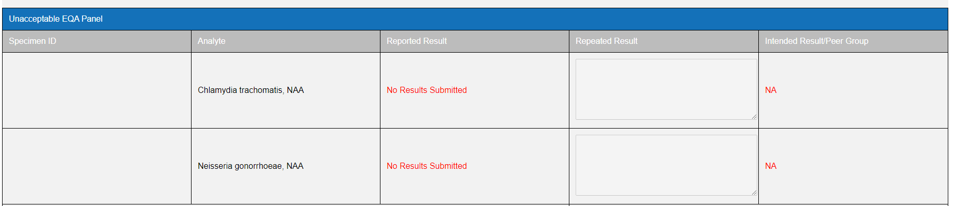

For surveys that have not been resulted and are graded as 0% in the Unacceptable EQA Panel section only one line per analytes will appear. See example below.
If results can be run then they should be attached as a document and “See Attachment” enter in Repeated Result box .
If results cannot be run then fill out the Explanation section.
Notes:
If for whatever reason the site does not enter results for a survey and does not contact pSMILE a score of 0% will be given. For these analytes only one line will appear for all results. If the survey can be run the site should attach the results to the investigation which will be explain in this training. In the Repeated Result box enter: “See Attachments”. If the results cannot be run then in the Explanation box enter the reason why they were not.

Slide 16
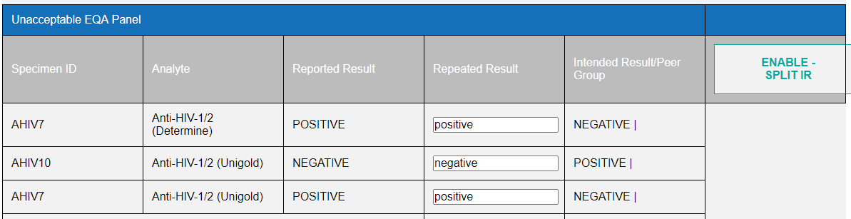
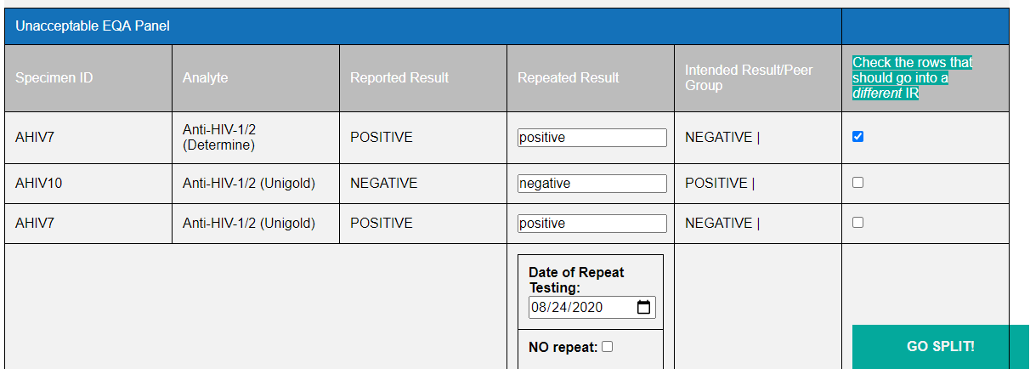
Notes:
If the survey has several analytes that require an investigation the laboratory needs to decide if need only one investigation or multiple. If investigation shows same cause can use one but if different causes then they should be split. If you need to split click on the Enable Split IR, Then click in box of analyte to split , then click on “go split”

Slide 17
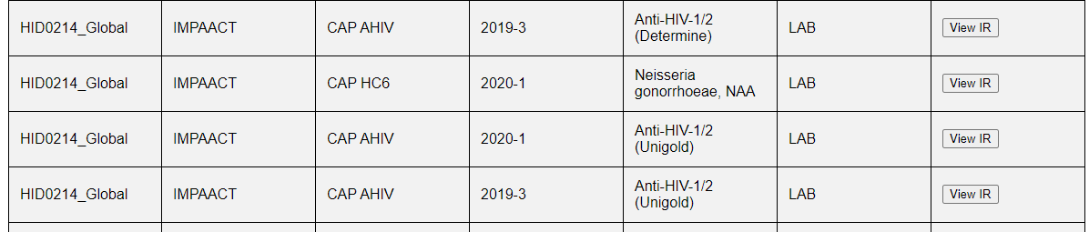
Notes:
. This will create two separate ones in this case. Just make sure you want them separate. Can’t put back together

Slide 18
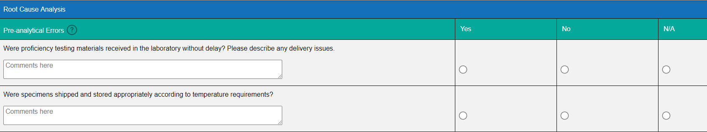
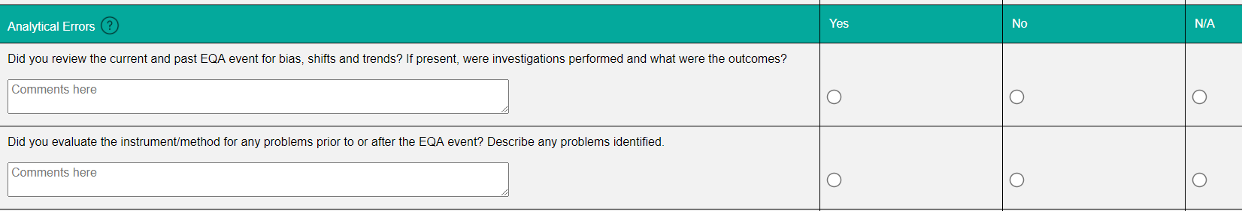
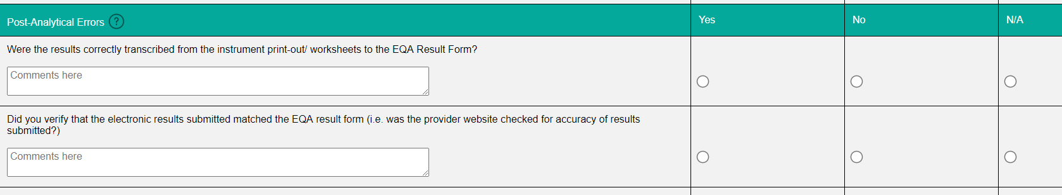
Notes:
Under the three section – Pre-Analytical, Analytical and Post Analytical need to check the appropriate box and add any comments to help explain choice such as Survey arrived warm temperature was 37 C upon receipt.

Slide 19
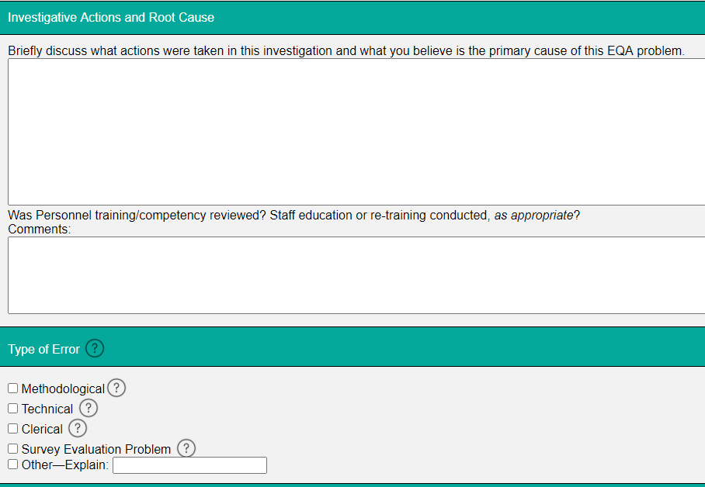
Notes:
Fill in the Investigative Actions and Root Cause, Personnel training/competency reviewed, and Type of error if check “Other” must explain what it was

Slide 20
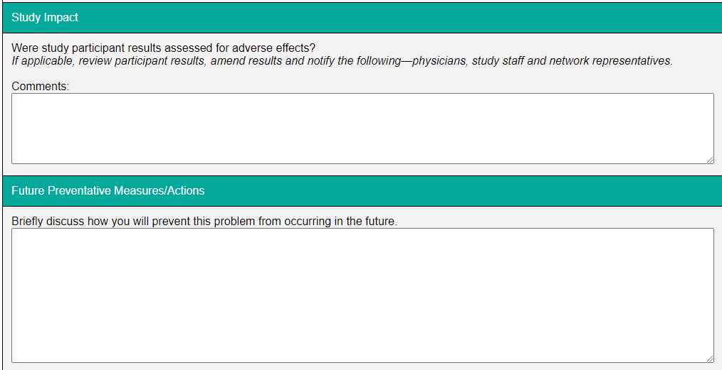
Notes:
Finally fill in the Study Impact and Future Preventative Measures/Action

Slide 21
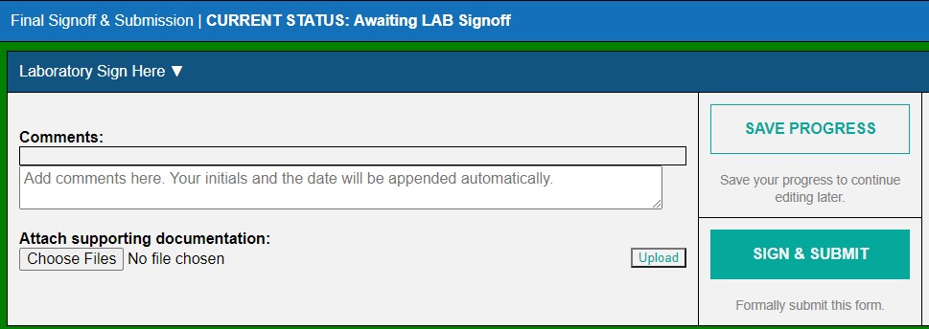
Notes:
The final section to fill in is the Final Signoff and Submission section. If you have any other comments to add put in the comment box. You don’t need to enter anything here if don’t want. At any point in completing the IR form you can save your work using the “Save Progress” button. Everything already filled out will be saved..

Slide 22
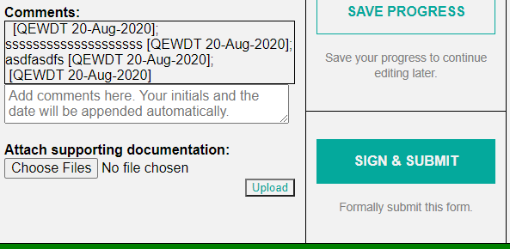
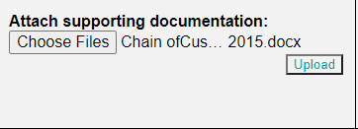
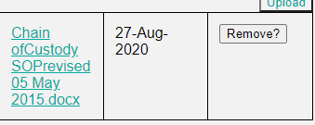
Notes:
If you have any documents for your investigations such as repeated results sheets, QC charts, service reports these can be submitted to be reviewed by SMILE and the Networks by using the ‘Choose Files’ button. This will open a tab to navigate to the documents. Once document is chosen click open and it will appear in this section. Click on “Upload” to attach. The document will appear and you can click on it to open to confirm correct document. If not can remove using the “Remove” button.

Slide 23
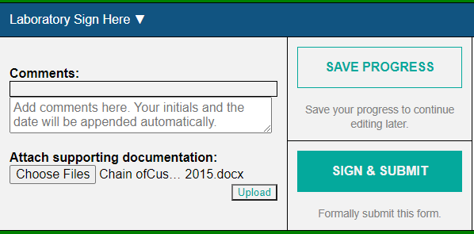
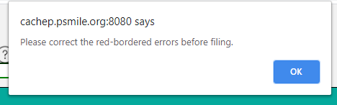
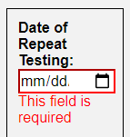
Notes:
. Once all fields have been completed the investigation can be submitted by using the Sign & Submit button. If there are any missing fields will get a pop-up telling you to complete required fields that will show up in red saying This Field is required.

Slide 24
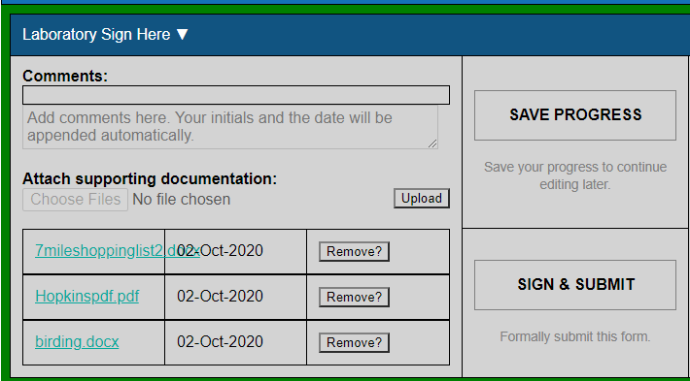
Notes:
If there are any supporting documents attached to the investigation, these can be viewed by going to the “Laboratory Sign Here” section and clicking on any of the uploaded documents. Be aware that if the lab has not entered any results and the grade is 0% there will be only on line under the Unacceptable Result Panel” and if the laboratory has run the survey the results will be attached as a document.

Slide 25
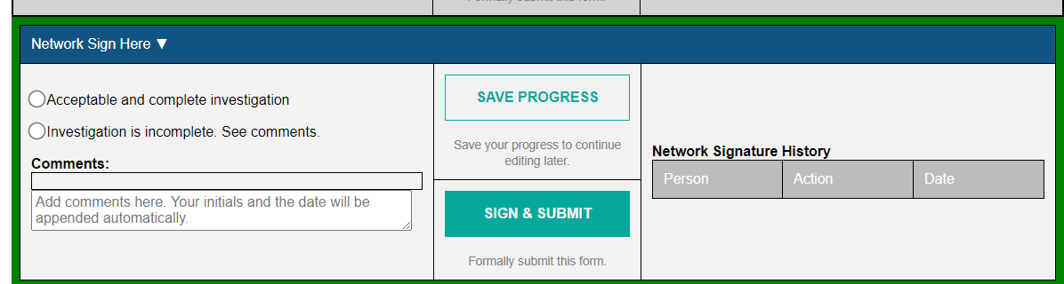
Notes:
When the investigation is ready for the PNL to review, the Network Sign Here section will become available. Please be aware that if any network representative who is not the PNL, they will not be able to accept or reject the investigation.
The PNL should review the completed investigation and either accept or reject as needed. If it is rejected the reason for rejection should be entered into the Comment section so that the laboratory will know what additional information is needed. The investigation will be returned to the laboratory for further investigation.
When the investigation is accepted by both the Network and SMILE an email will be sent to email list notifying that the investigation is ready for pSMILE closed.

Slide 26
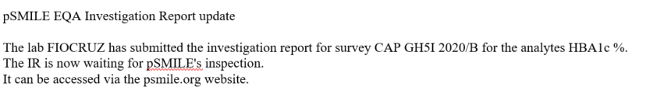
An email will be sent to the laboratory, Networks and pSMILE after the laboratory has submitted the investigation.
pSMILE will review the completed investigation.
Notes:
The following slides are examples of the emails that will be sent showing the progress of the investigation. The first will be sent when the laboratory submits the investigation. All networks will have access to view the investigation at any time in the process.

Slide 27
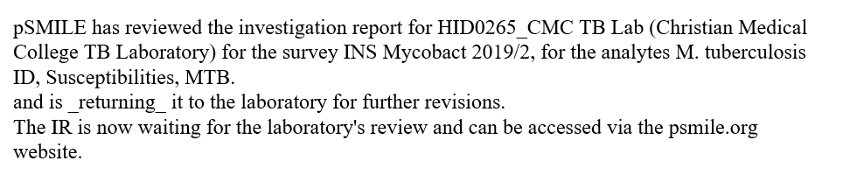
pSMILE will review the entire Investigation and either accept or reject the IR.
If rejected, an email will be sent out informing the laboratory.
The email will also be sent to laboratory and pSMILE.
Notes:
If SMILE rejects the investigation, the IR will be sent back to the laboratory with comments added for the laboratory to complete the IR

Slide 28
After pSMILE accepts the Investigation the Laboratory, pSMILE and all Networks will receive an email saying it is ready for PNL review.
The Network PNL will review the IR.
Notes:
If SMILE accepts the IR, then it will be sent to the PNL for review

Slide 29
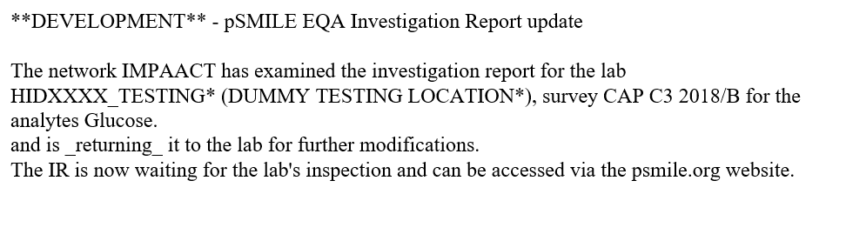
The PNL will have the choice of accepting or rejecting the Investigation. If rejected the IR will be returned to the laboratory to revise.
An email will be sent to the laboratory, pSMILE and PNL Networks saying it is back with the laboratory.
Notes:
If the IR is rejected by the Network, it will be sent back to the laboratory with a comment for completion in the Network Sign Here section. An email will be sent again to the main contact and person that completed IR. Once lab re-submitted the investigation, will return to SMILE to review and eventually to the Network PNL

Slide 30
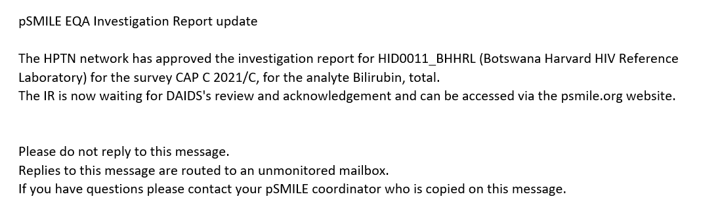
Once PNL accepts the Investigation and email will be sent to the DAIDS POC to acknowledge the investigation.
Notes:
Once accepted by both SMILE and PNL an email is sent to DAIDS POC for acknowledgement.

Slide 31
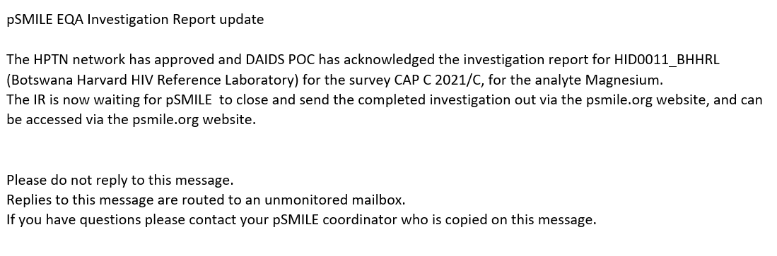
pSMILE will close the Investigation and combine all investigations with any supporting documents.
pSMILE will email the completed Investigation to the laboratory email distribution group.
Notes:
Once the DAIDS POC has acknowledge and email will be sent to the lab and pSMILE coordinators to close the investigation. The coordinator will print out the completed IR and attach any documents that were submitted by the laboratory. If there are multiple IRs for one survey, all will be combined into one PDF. This will then be sent out to the mail group for that laboratory.

Slide 32


Questions

